Slide 1


MAP Lab
LAB 4: GPIO Interrupts TM4C123 Tiva Launchpad – External Interrupts
Kshitij Hemant Gurjar (SY M.Tech VLSI)
Prof. Y.M. Vaidya
Swapnil Phalke (SY M.Tech VLSI)
MAP Lab

Slide 2
AIM
In this tutorial, we will discuss how to use GPIO interrupts which are also known as external interrupts of ARM Cortex M4 based TM4C123 microcontroller using the Tiva C launchpad. We will learn to configure GPIO interrupts as an edge triggered such as positive or negative edge or level triggered such as active high or active low level triggered.
LAB 1 Introduction to TM4C123
Kshitij Hemant Gurjar (SY M.Tech VLSI)
Prof. Y.M. Vaidya
Swapnil Phalke (SY M.Tech VLSI)
MAP Lab

Slide 3
GPIO Interrupts Introduction
General-purpose input-output pins are the vital components of embedded systems. GPIO pins allow easy integration of external components with microcontrollers. Input pins allow microcontrollers to receive information from the external world and output pins are used to display information or control devices such as motors, etc.
In the last tutorial on controlling an LED with push button using TM4C123 Tiva C launchpad, we have seen an example to control an onboard LED of Tiva Launchpad using onboard switches such as SW1 (PF0) and SW2 (PF4). In that tutorial, the TM4C123 microcontroller keeps checking the status of the push button by polling PF0 and PF4 bits of PORTF of TM4C123G microcontroller. But one of the main drawbacks of the polling method is that microcontroller will have to check the status of input switches on every sequential execution of the code or keep monitoring continuously (Polling method). Therefore, external or GPIO interrupts are used to synchronize external physical devices with microcontrollers.
Hence, instead of checking the status of input switches continuously, a GPIO pin which is configured as digital input, can be initialized to produce an interrupt whenever the state of the switch changes. A source of interrupt trigger can be on falling edges, rising edges or both falling and rising edges, level triggered also.
LAB 1 Introduction to TM4C123
In summary, use of external GPIO interrupts makes embedded system event driven, responsive and they make use of microcontroller’s processing time and resources efficiently.
Kshitij Hemant Gurjar (SY M.Tech VLSI)
Prof. Y.M. Vaidya
Swapnil Phalke (SY M.Tech VLSI)
MAP Lab

Slide 4
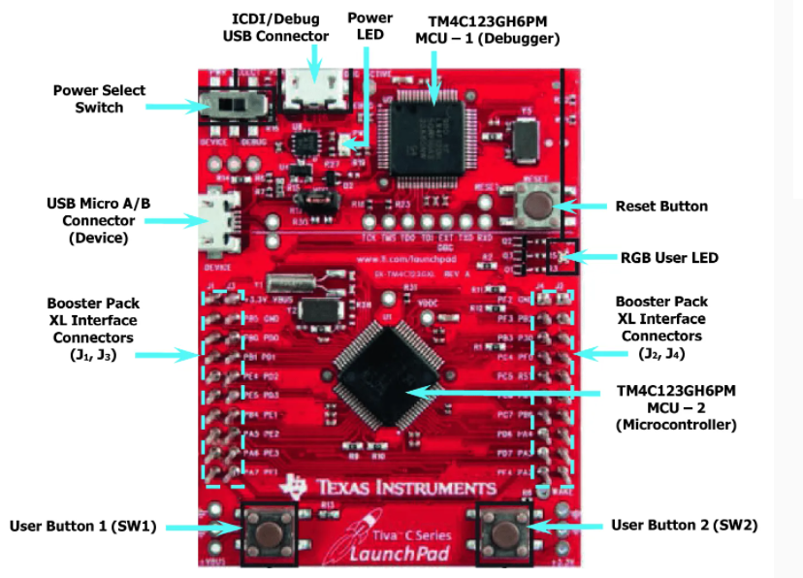
Kshitij Hemant Gurjar (SY M.Tech VLSI)
Prof. Y.M. Vaidya
Swapnil Phalke (SY M.Tech VLSI)
MAP Lab

Slide 5
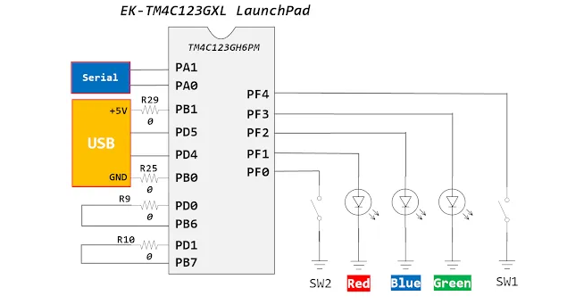
Kshitij Hemant Gurjar (SY M.Tech VLSI)
Prof. Y.M. Vaidya
Swapnil Phalke (SY M.Tech VLSI)
MAP Lab

Slide 6
How to Configure External Interrupts of TM4C123
TM4C123 microcontroller has an integrated Nested Vectored Interrupt Controller (NVIC) which manages all interrupt requests which are issued either by a processor (exceptions) or peripherals(IRQs). TM4C123GH6PM microcontroller supports 76 peripheral interrupts (some are reserved) and each interrupt has a unique number assigned to it. This interrupt number is defined inside the startup file and header file of TM4C123GH6PM.
NVIC identifies each exception or peripheral interrupt by its numbers. If you see table 2.9 in the datasheet of TM4C123GH6PM MCU, you will find the unique number assigned to each exception and peripheral interrupt. As you can see in the second column of figure shown below, the interrupt number of GPIO PORTF is 30. But one important thing to note here is that PORTF has 8 pins and only one interrupt number is assigned to all the pins of PORTF. This is because the separate interrupt register is used to distinguish which pin of PORTF caused the interrupt
Kshitij Hemant Gurjar (SY M.Tech VLSI)
Prof. Y.M. Vaidya
Swapnil Phalke (SY M.Tech VLSI)
MAP Lab

Slide 7
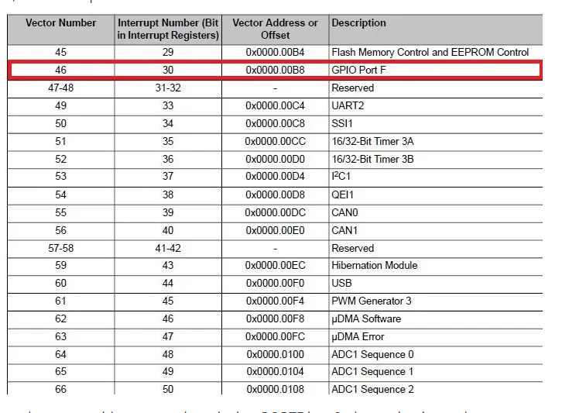
Kshitij Hemant Gurjar (SY M.Tech VLSI)
Prof. Y.M. Vaidya
Swapnil Phalke (SY M.Tech VLSI)
MAP Lab

Slide 8
Enable GPIO Interrupts
Before enabling any peripheral interrupt, we must enable the source of interrupt requests for this particular interrupt source using the NVIC interrupt control register. In the interrupt vector table, there is an interrupt enable bit number for each interrupt source. We can enable these interrupt bits using NVIC interrupt enable registers. There are four NVIC interrupts enable registers such as EN0(ISER[0]), EN1(ISER[1]), EN2(ISER[2]) and EN3(ISER[3]).
The ENn(ISER[n])registers enable interrupts and shows which interrupts are enabled. Bit0 of EN0 corresponds to Interrupt 0; bit31 corresponds to Interrupt 31. Bit 0 of EN1(ISER[1])corresponds to Interrupt 32; bit31 corresponds to Interrupt 63 and so on other two registers.
For example, the interrupt number of PORTF is IRQ30. Hence the corresponding NVIC interrupt enable register of PORTF is ISER[0] and setting bit 30 of ISER[0] will enable the PORTF interrupt.
Kshitij Hemant Gurjar (SY M.Tech VLSI)
Prof. Y.M. Vaidya
Swapnil Phalke (SY M.Tech VLSI)
MAP Lab

Slide 9
Enable GPIO Interrupts
After enabling interrupt in NVIC register, enable the interrupt of the peripheral which you want to use. For example, we will be using GPIOF pins interrupt. In order to enable GPIO interrupt GPIO interrupt mask enable register is used. First eight bits of GPIOIM register enable or disable interrupt functionality for each pin as shown in figure below:
For example, we will use PF0 and PF4 pins of PORTF to get SW1 and SW2 status on interrupt. This line enables interrupt for PF0 and PF4 pins
Kshitij Hemant Gurjar (SY M.Tech VLSI)
Prof. Y.M. Vaidya
Swapnil Phalke (SY M.Tech VLSI)
MAP Lab

Slide 10
GPIO Interrupt edge or level triggered setting (GPIOIS)
As we mentioned earlier, external GPIO interrupts of TM4C123G microcontroller can be configured in four modes:
Positive edge triggered
Negative edge triggered
Positive Level ( active high)
Negative Level (active low)
GPIO interrupt sense register is used to configure respective pins either as a level or edge triggered. Setting a bit in the GPIOIS register configures the corresponding pin to detect levels while clearing a bit configures the corresponding pin to detect edges
Kshitij Hemant Gurjar (SY M.Tech VLSI)
Prof. Y.M. Vaidya
Swapnil Phalke (SY M.Tech VLSI)
MAP Lab

Slide 11
GPIO Interrupt Even Register (GPIOIEV)
GPIOIS register only configures the pins as level or edge triggered. But we should also configure the pin either as a positive/negative edge or positive/negative level triggered. Setting the respective bit in GPIOIEV register configures the corresponding pin to detect positive edge or positive level depending on in which mode pin is configured in GPIOIS register. Similarly, Clearing the respective bit in GPIOIEV register configures the corresponding pin to detect negative edge or negative level.
Kshitij Hemant Gurjar (SY M.Tech VLSI)
Prof. Y.M. Vaidya
Swapnil Phalke (SY M.Tech VLSI)
MAP Lab

Slide 12
GPIO Interrupt Both Edges (GPIOIBE)
We can also configure GPIO pins to cause interrupt on both positive or negative edges. GPIOIBE register is used to configure each pin to cause an interrupt on both edges. setting a bit in the GPIOIBE register configures the corresponding pin to detect both rising and falling edges, regardless of the corresponding bit in the GPIO Interrupt Event (GPIOIEV) register (see page 666). Clearing a bit configures the pin to be controlled by the GPIOIEV register.
Kshitij Hemant Gurjar (SY M.Tech VLSI)
Prof. Y.M. Vaidya
Swapnil Phalke (SY M.Tech VLSI)
MAP Lab

Slide 13
GPIO Interrupt Both Edges (GPIOIBE)
We can also configure GPIO pins to cause interrupt on both positive or negative edges. GPIOIBE register is used to configure each pin to cause an interrupt on both edges. setting a bit in the GPIOIBE register configures the corresponding pin to detect both rising and falling edges, regardless of the corresponding bit in the GPIO Interrupt Event (GPIOIEV) register (see page 666). Clearing a bit configures the pin to be controlled by the GPIOIEV register.
Kshitij Hemant Gurjar (SY M.Tech VLSI)
Prof. Y.M. Vaidya
Swapnil Phalke (SY M.Tech VLSI)
MAP Lab

